Slide 1
The Intertemporal Evolution of Agriculture and Labor over a Rapid Structural Transformation: Lessons from Vietnam
Yanyan Liu, Christopher B. Barrett, Trinh Pham, William Violette*
IFAD/UC-Davis/World Bank Conference on
The Future of Work in Agriculture
Washington, DC
March 20, 2019
* Any opinions or views expressed herein are those of the authors and do not necessarily represent the views of the Federal Trade Commission or its Commissioners.

Slide 2
Objective
Provide a detailed description of the evolution of rural labor markets and agriculture over the course of Vietnam’s rapid structural transformation over the past quarter century.
Availability of long-term nationally representative household datasets offers uncommon opportunity to study a rapidly evolving rural economy.
VLSS/VHLSS 1992-2016 (10 rounds, rotating household panels)
LFS: 2007- 2016 (6 rounds, individual worker data)
Add to the emerging literature on structural transformation in low-income countries using micro-level data.
Descriptive evidence to help to answer several policy-related questions relevant to today’s low-income agrarian nations.

Slide 3
Why Vietnam?
For 3 decades, Vietnam has undergone one of the most rapid structural transformations of any low-income agrarian nation in history. Sustained GDP growth 4–8% pa, rapid poverty reduction, improved HDI indicators.
1992 Vietnam: ~$500/yr 2010 GNIpc and 34% GDP in ag (mainly rice, cassava, tree crops) … Very similar to Liberia today. More agrarian than today’s Malawi, Mozambique. Poorer and more agrarian than Burkina Faso, Ethiopia, Haiti, Nepal, Rwanda, Tanzania, Uganda,
Today’s Vietnam: $2342 GNIpc, 15% ag/GDP … (lower-)middle income country (like Egypt, India).

Slide 4
Key Policy Questions
Does structural transformation lead to regional specialization, with rural areas concentrating in farming and losing workers who leave for cities? Mostly yes
Do we see rapid migration into the non-farm sector within rural areas as well as urban? Yes
Does an increasingly productive farming sector absorb young workers? Not much
Do we see convergence in farm and non-farm wages; rural and urban wages? Yes
Do minimum wage laws - enacted primarily for urban non-farm workers - bind in ag sector? Less as the sector integrates w/non-farm
Does structural transformation lead to farm consoliation, mechanization, and the displacement of workers? No, Yes, No
Does the inverse farm size-productivity relationship - commonly observed in developing countries - attenuate over time, suggesting more competitive and integrated rural factor markets and less rationale for agricultural policies favoring smaller farms? Yes
Is structural transformation associated with rapid increases in well-being for households that remain in rural areas? Yes

Slide 5
Data: VLSS/VHLSS 1992-2016
Rotating panel design
Survey instrument: Commune & household
Representative at national, regional, urban, rural, and provincial levels

Slide 6
Data: LFS 2007-2016
Representative at the national, urban, rural, and regional level
6-round repeated cross-sectional data
Household information: demographics
Individual information: education, employment status, occupation, wage, work conditions etc.
Survey round | Total individuals (persons) | Rural individuals (persons) | Estimated share of rural individuals (%) | Estimated labor force participation rate (%)
 |  |  |  | Total | Rural
2007 | 496,842 | 182,656 | 70.46 | 80.78 | 83.95
2009 | 49,431 | 21,729 | 69.24 | 82.42 | 85.03
2011 | 842,092 | 334,663 | 67.21 | 82.84 | 86.20
2012 | 562,168 | 288,426 | 66.71 | 82.98 | 85.98
2014 | 560,642 | 286,797 | 66.89 | 84.18 | 87.25
2016 | 615,986 | 348,445 | 64.72 | 83.52 | 86.96

Slide 7
Share of Households Involved in Agriculture (VHLSS)
Steady decline in ag participation, esp. in most urban regions (Red River Delta, South East) and emergent regional differentiation.
 | 1992 | 2002 | 2010 | 2016
Rural | 0.950 | 0.907 | 0.820 | 0.810
Total | 0.835 | 0.758 | 0.637 | 0.629
By region
Central Highlands | 0.961 | 0.894 | 0.805 | 0.814
Mekong River Delta | 0.844 | 0.787 | 0.675 | 0.666
North and South-Central Coast | 0.955 | 0.872 | 0.798 | 0.826
North East and North West | 0.875 | 0.819 | 0.746 | 0.749
Red River Delta | 0.838 | 0.777 | 0.651 | 0.563
South East | 0.533 | 0.439 | 0.297 | 0.307

Slide 8
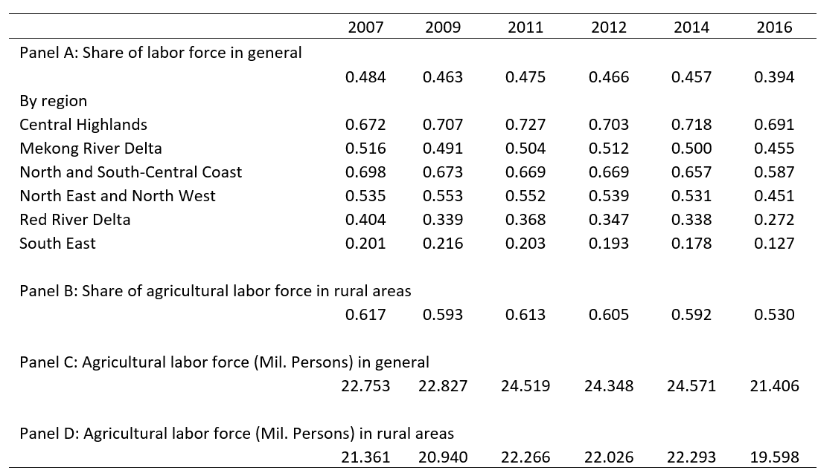
Agriculture Labor Force (LFS)
Share of workforce in ag lower and falls more slowly overall, rising in some regions. But only 53% of rural workforce is in ag by 2016.

Slide 9
Farming Within Ag Households (VHLSS)
Diversification into non-farm happening within ag households, too. Even among farm hhs, full-time farmers fell from 31 to 16% 2002-16.

Slide 10
Median Share of Agricultural Income and Wage Income in Total Household Income, 2002-2016 (VHLSS)
As in today’s high-income countries, since 2010, wage income has exceeded farm income among rural households

Slide 11
Labor Force Composition by Age, Gender and Education (LFS)
The agricultural workforce is aging faster than the overall workforce. Educational attainment growing very rapidly. Women’s workforce participation is high, and higher in ag than non-farm sectors.

Slide 12
Median daily real male and female agricultural wages
Rapid growth in real agricultural wages in rural Vietnam, from $1.15-1.32/day in 1992 to $3.96-4.42/day in 2010 (in 2010 constant US$). ~7% annualized ag wage growth rate > national GDP growth rate.

Slide 13
Was higher wage driven by minimum wage rates?
Mean/median wages increasingly exceed minimum wages, but also growing share of individual workers < mw … increased dispersion, especially in most agrarian regions.

Slide 14
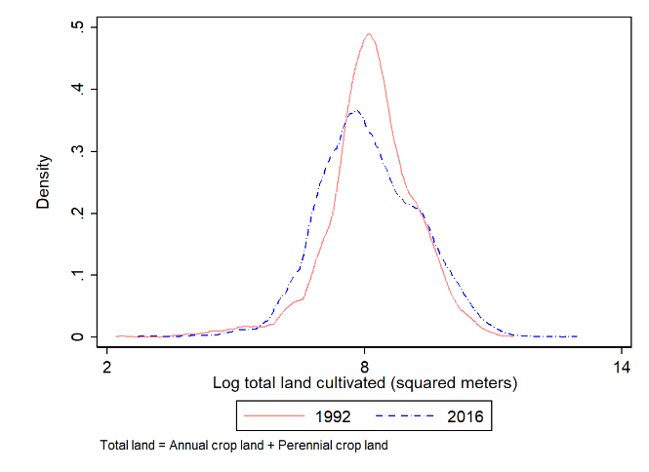
Farm size and land rental market
Vietnam’s agriculture remains small farm based. Very little land rental; mainly owner cultivated. 0.3/0.6 hectare median/mean size.
Distribution of total cultivated land per household
Proportion of households which rent in/out land

Slide 15
Machinery adoption versus farm size, 1992-2016
Clear economies of scale, manifest in a pronounced positive relation b/n land-machinery ownership. Rental markets have virtually erased the farm size gradient in machinery use, leading to rapid mechanization in response to rising real wages and non-farm diversification of farm hhs.

Slide 16
Fertilizer and pesticide adoption versus farm size, 1992-2016
Differentiated agrochemical use patterns, with labor-saving pesticide use becoming more uniform, as with mechanization, and labor-demanding fertilizer use more size-biased. Seems also a response to rising real wages and non-farm diversification of farm hhs that make labor scarcer/dearer.

Slide 17
Rice yield versus farm size, 1992-2016
Rapid rice yield growth in initial years (1992-2002), but slower growth 2002-2016.

Slide 18
Regression result: rice yield on log planting area
Inverse farm size-productivity relationship has long signaled multiple rural market failures and supported policies favoring small farmers. IFSPR has attenuated dramatically in Vietnam since 1992.

Slide 19
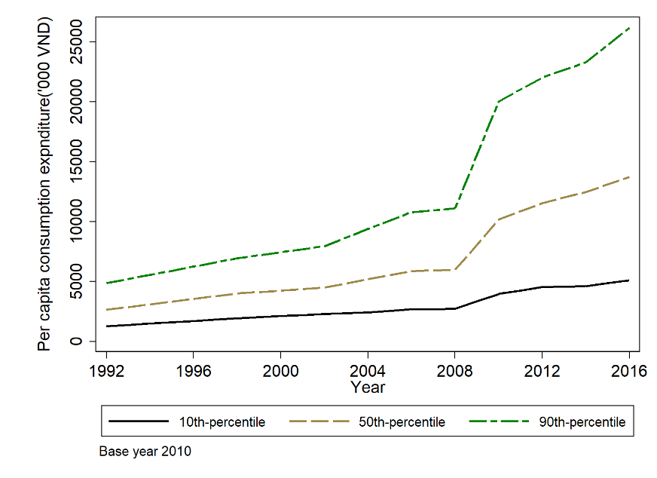
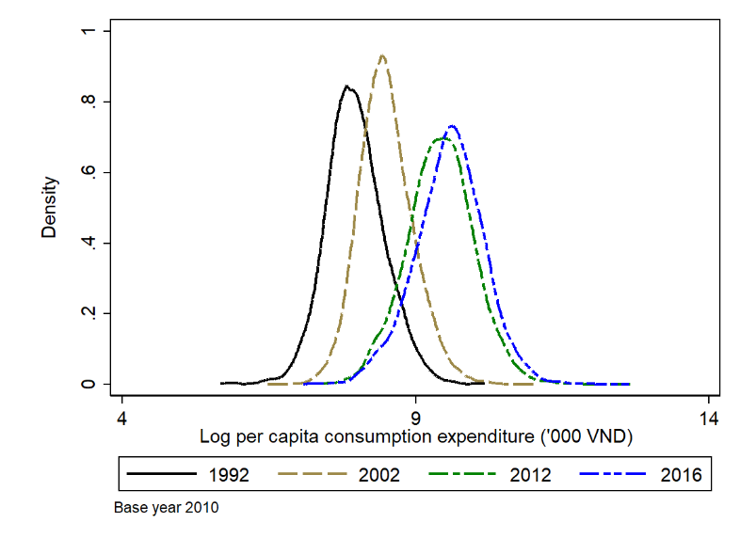
Per capita real consumption expenditure, 1992-2016
Rural well-being improved steadily, but growing inequality too. Median ( base 2010) exp pc grew from $10.11/m to $52.75/mo, 1992-2016.
10, 50, 90 percentiles of expenditure p.c.
Distribution of log expenditure p.c.

Slide 20
Correlates of Household Expenditures pc
Land holdings steadily decline, educational attainment rises in partial correlation with exp pc, while hh size penalty grows.

Slide 21
Summary of findings
The agricultural labor force is slowly shrinking and aging more rapidly than is the labor force as a whole. Potential ag employment of youth is limited.
Even farming families are diversifying out of agriculture, increasingly earning more of their total household income from the non-farm sector.
Real wage convergence across sectors and rural-urban regions has gone hand-in-hand with increased diversification of the rural economy into the non-farm sector nationwide and rapid advances in educational attainment in all sectors’ and regions’ workforce.
Enhanced inter-sectoral integration also manifests in steady attenuation of the longstanding inverse farm size-yield relationship.
Minimum wage restrictions do not seem to explain growth in real agricultural wages. Indeed, noncompliance w/ min wage laws has been increasing, especially in the most agriculturally dependent regions.
Farming remained smallholder household-based. No farm consolidation. But robust mechanization thanks to emergence of vibrant equipment rental markets. Agrochemicals likewise show effects of rural labor changes.
Rural nonfarm expansion assoc w/sharply improved rural well-being. Living standards increasingly driven by human capital, less by landholdings.

Slide 22
Thank you for your interest and comments!

